Slide 1
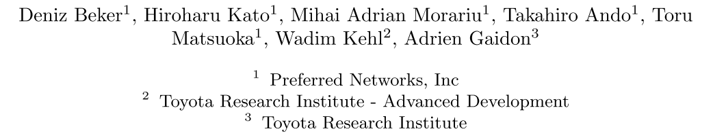
Monocular Differentiable Rendering for Self-Supervised 3D Object Detection
ECCV 2020

Slide 2
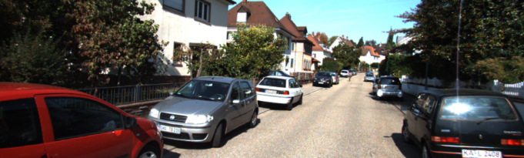
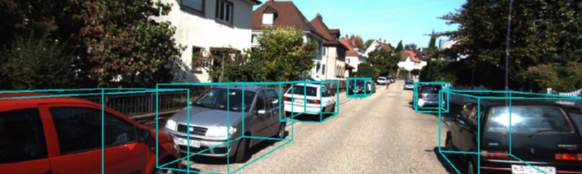
Introduction
Monocular 3D Object Detection Task:
Monocular 3D Object Detection Methods:
3D anchor based
Keypoints based
Pseudo-Lidar based
3D Reconstruction based

Slide 3
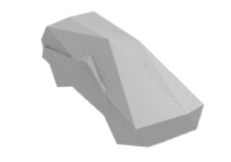
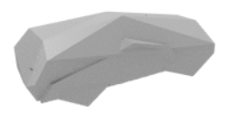
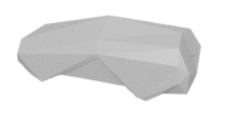
Prior Knowledge
3D mesh:
用顶点与多边形表示三维物体
Render:
Rendering is the process of generating an image from a 2D or 3D model (or models in what collectively could be called a scene file), by means of computer programs.
3D的mesh绘制到2D屏幕平面
In 3D computer graphics and solid modeling, a polygon mesh is a collection of vertices, edges and faces that defines the shape of a polyhedral object.

Slide 4
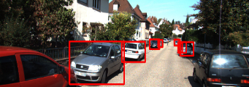
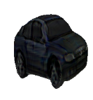
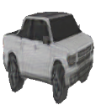

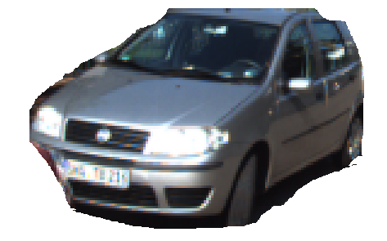

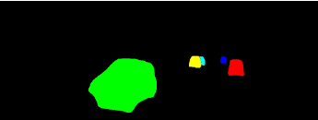
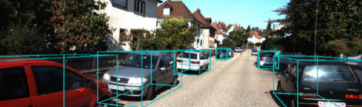
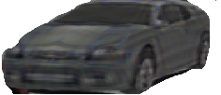
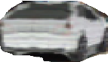
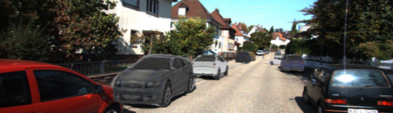
Motivation
2D Image
2D Detect&Depth
&Instance Segment
Instance patches
3D mesh
analysis by synthesis
3D Locations
Rendering
Compare With silhouette, bounding box, depth map and pixel colors

Slide 5
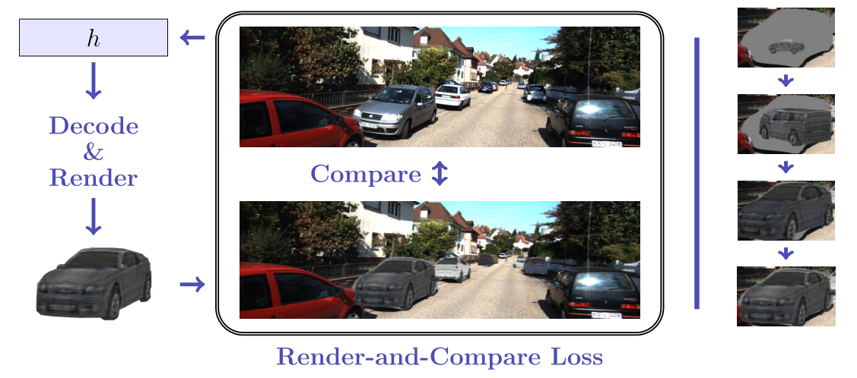
Analysis-by-synthesis
通过合成分析（analysis by synthesis）来渲染：视觉系统抽取场景参数，图形系统基于这些参数渲染图像。

Slide 6
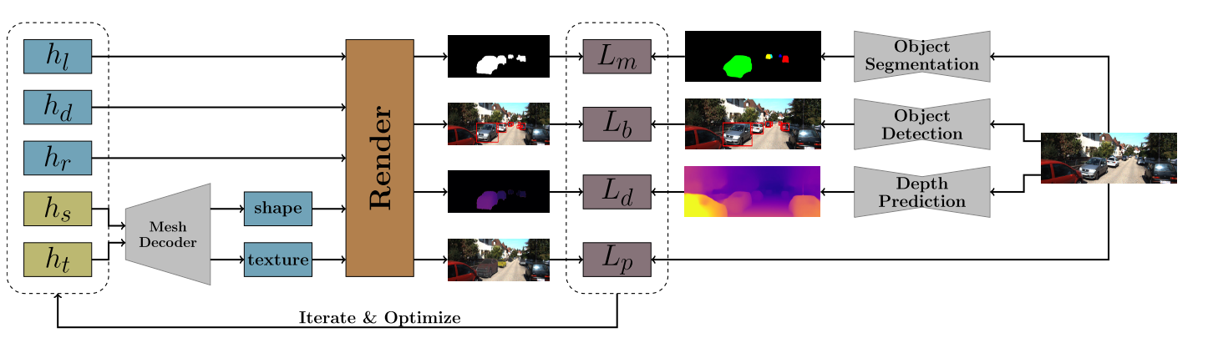
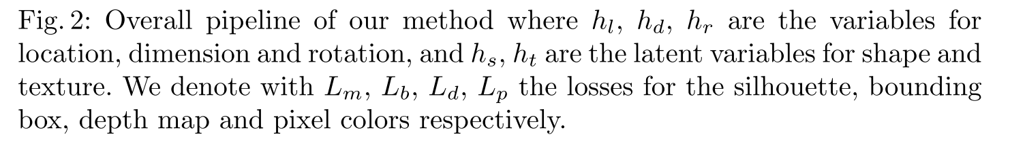
Pipeline

Slide 7
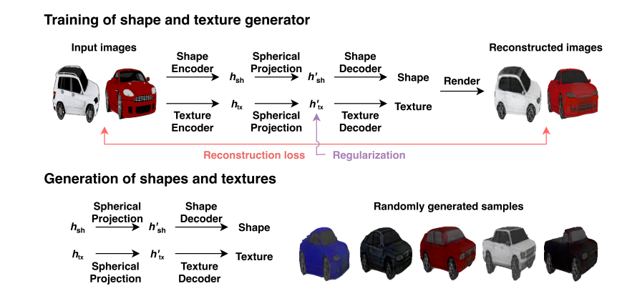
Method : Mesh generation and Rendering
Learning View Priors for Single-view 3D Reconstruction.
Neural 3D Mesh Renderer.

Slide 8
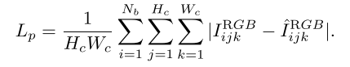
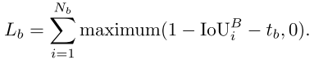
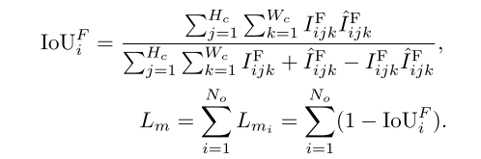
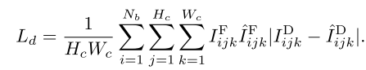

Loss
Pixel Map Difference
Bounding Box Difference
Silhouette Difference
Depth Map Difference
Overall

Slide 9
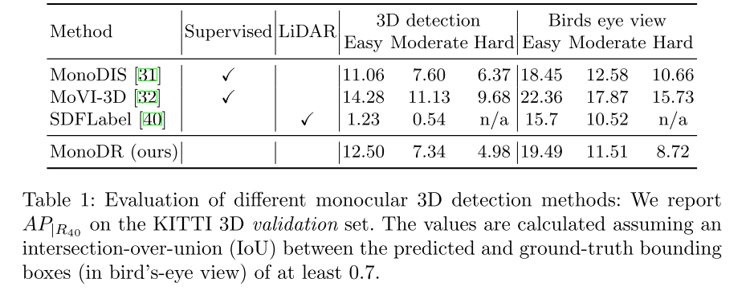
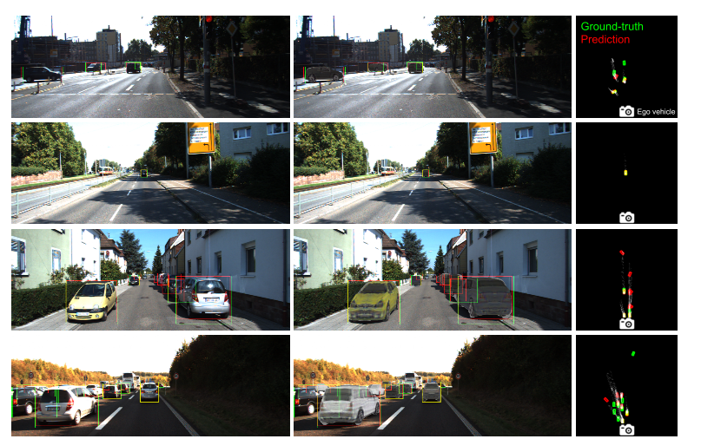
Experiment

Slide 10
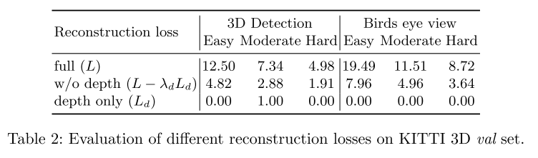
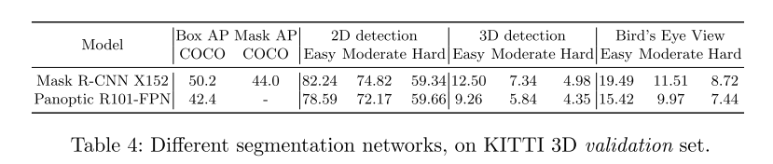
Ablation Study

